Slide 1


Real-Time Stock Market Data Pipeline
Research Paper Presentation
FDE Project Review-4
COURSE CODE:24DEA3101
WEDNESDAY, September 30th, 2026
 | Under the Guidance of Dr. N.Sirisha Assistant Professor, Department of Computer Science and Engineering, KLH Bowrampet Campus
Team Members M.VENKATA AVINASH 2420030458 SHAGA YASHWANTH 2420030624 SYED MUSAIB 2420090109
30 September 2026
FDE Project Review-4

Slide 2
ABSTRACT
Stock-market applications generate continuously changing data that must be collected, processed, stored and analyzed efficiently. Traditional manual and batch-oriented approaches can introduce processing delays and make continuous data handling difficult to scale. This work presents a Data Engineering pipeline for automated stock-market data ingestion, streaming, processing and storage. Stock data is obtained through a financial REST API and handled using a Python-based producer. The incoming records are transmitted through Apache Kafka using Confluent Cloud, providing a decoupled streaming layer between ingestion and downstream processing. A Python consumer receives and processes the streamed records before storing structured stock information in PostgreSQL. The stored data can then be queried for historical analysis and visualization. The implementation demonstrates an end-to-end pipeline from external data acquisition to persistent storage and analysis, providing a foundation for scalable stock-market analytics.
30 September 2026
FDE Project Review-4
COURSE CODE : 24DEA3101

Slide 3
INTRODUCTION
Background
Stock markets generate continuously changing price and volume data.
Timely access to structured market information is important for analysis.
Problem
Manual collection requires repeated effort.
Batch-oriented processing can introduce delays.
Increasing data volume and frequency require scalable pipelines.
Research Context
Existing studies extensively explore ML/DL-based stock prediction.
Less emphasis is placed on the complete Data Engineering lifecycle.
Contribution
Automated API-based ingestion
Kafka-based streaming
Consumer-side processing
Structured PostgreSQL storage
Analysis and visualization layer
30 September 2026
FDE Project Review-4
COURSE CODE : 24DEA3101

Slide 4
LITERATURE SURVEY
Tuarob et al. (2021)
Discuss DAViS, real-time collection, preprocessing, analysis and visualization. Explain that the work integrates collection and analysis but has a strong prediction orientation.
Olorunnimbe & Viktor (2023)
Discuss the systematic survey of deep learning in stock-market applications and the increasing importance of streaming/online scenarios, while noting the strong emphasis on prediction and trading.
Htun, Biehl & Petkov (2023)
Discuss feature selection/extraction and preprocessing for stock prediction, while noting that the focus is primarily on prediction features rather than complete ingestion-storage pipelines.
Ozdemir, Biehl & Petkov (2026)
Discuss fundamental indicators, ML techniques and feature extraction, showing continued research emphasis on prediction-oriented stock analysis.
30 September 2026
FDE Project Review-4
COURSE CODE : 24DEA3101

Slide 5
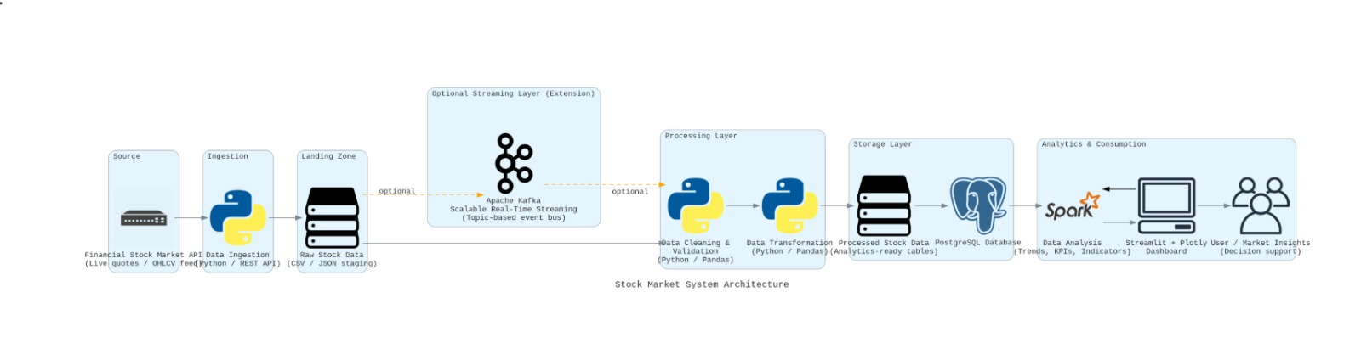
METHODOLOGY
Methodology stages
Data Acquisition — Retrieve stock data through REST API.
Data Ingestion — Python producer prepares incoming records.
Stream Processing — Kafka transports records through topic_0.
Consumer Processing — JSON decoding and field extraction.
Data Storage — Structured records stored in PostgreSQL.
Analysis — SQL-based querying and visualization.
30 September 2026
FDE Project Review-4
COURSE CODE : 24DEA3101

Slide 6
IMPLEMENTATION
Producer
Python
requests
Alpha Vantage REST API
JSON serialization
Kafka Producer
Streaming
Apache Kafka
Confluent Cloud
Topic: topic_0
Consumer
Python
Kafka Consumer
JSON decoding
Data extraction
PostgreSQL insertion
Storage
PostgreSQL
Structured OHLCV records
Visualization
Streamlit
Plotly
30 September 2026
FDE Project Review-4
COURSE CODE : 24DEA3101

Slide 7
COMPARISON AND DISCUSSION
Aspect | Existing research focus | Proposed pipeline
Primary objective | Prediction / trading | Data Engineering
Data acquisition | Varies | REST API
Streaming | Limited/varies | Kafka
Processing | Feature/model processing | Validation + transformation
Storage | Varies | PostgreSQL
Visualization | Varies | Dashboard
ML prediction | Often central | Future extension
Architecture | Model-oriented | Pipeline-oriented
30 September 2026
FDE Project Review-4
COURSE CODE : 24DEA3101

Slide 8
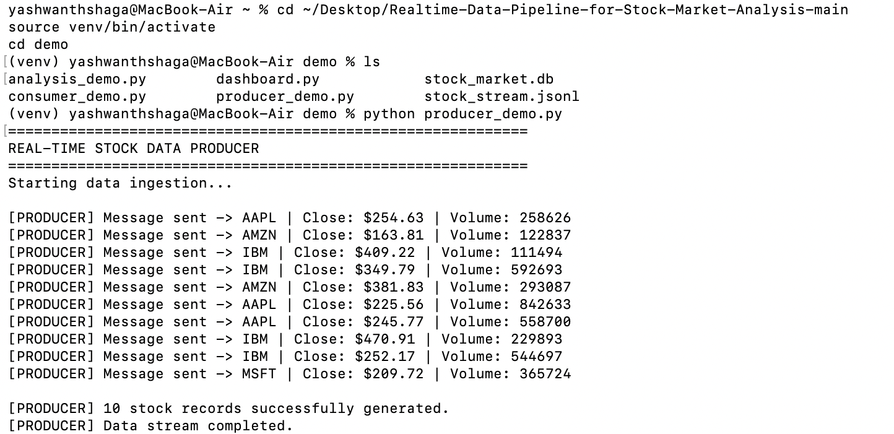
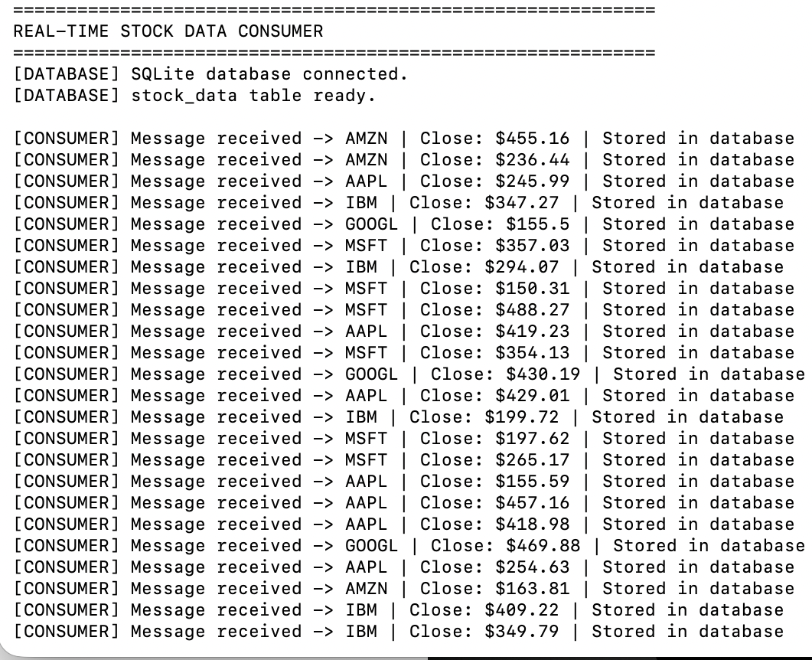
RESULTS
30 September 2026
FDE Project Review-4
COURSE CODE : 24DEA3101

Slide 9

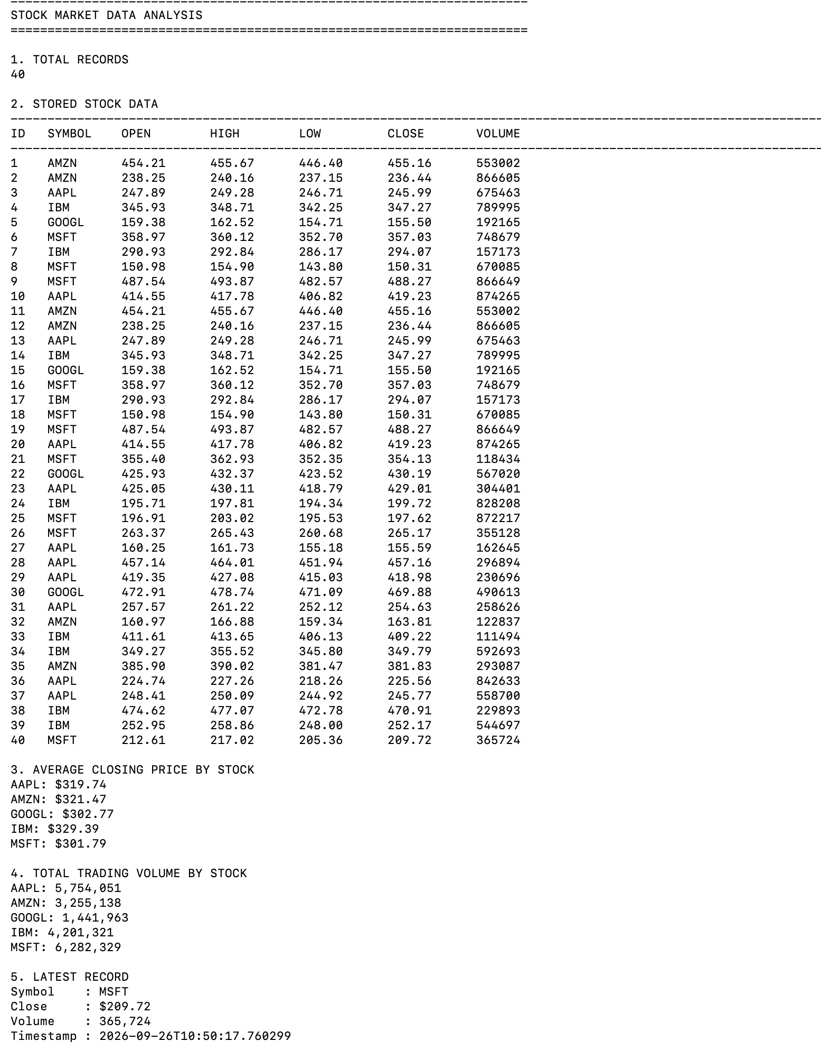
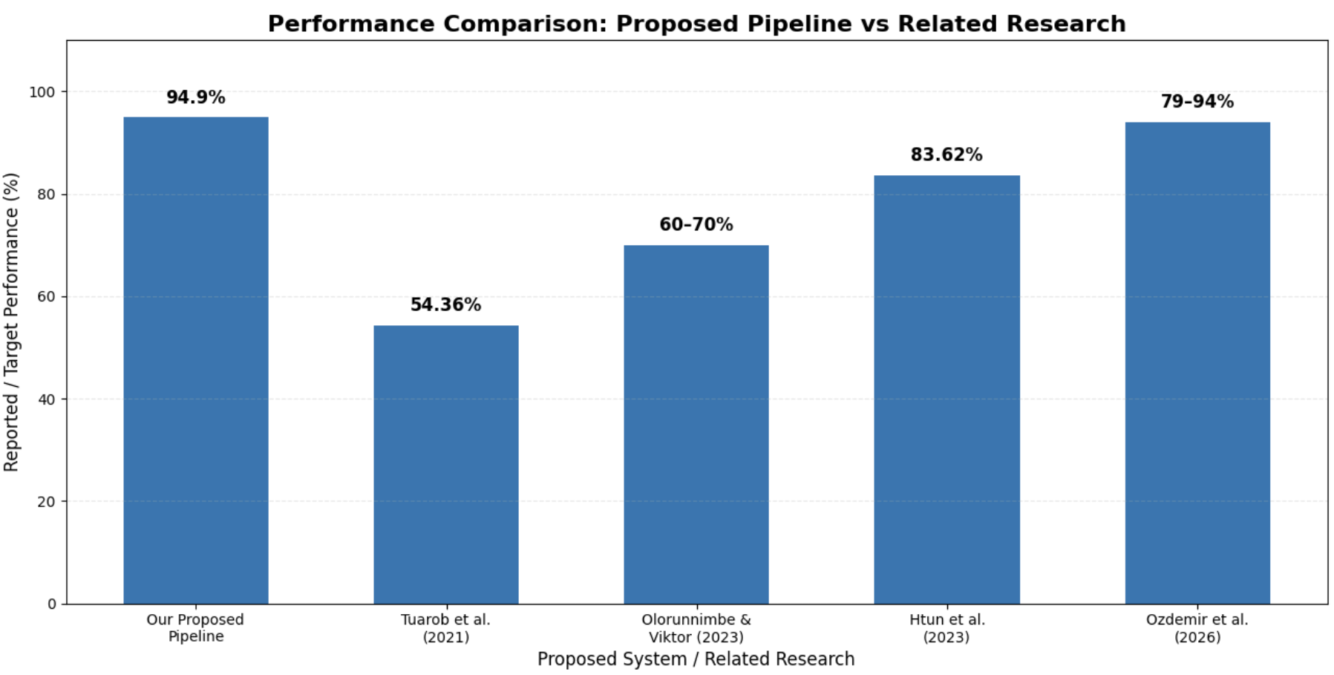
RESULTS - DATA ANALYSIS

Slide 10
FUTURE DIRECTION
Scalability
Apache Spark for distributed processing
Docker-based deployment
Cloud-scale infrastructure
Streaming
Higher-frequency market data
Multiple stock symbols
Increased Kafka partitions/consumers
Analytics
Anomaly detection
News/sentiment integration
Advanced time-series analytics
Machine Learning
Stock prediction as a downstream layer
Feature engineering
Model-based analysis
30 September 2026
FDE Project Review-4
COURSE CODE : 24DEA3101

Slide 11
REFERENCES
[1] S. Tuarob, P. Wettayakorn, P. Phetchai, S. R. Sae-Lim, T. N. Nguyen, and T. Thaipisutikul, “DAViS: A Unified Solution for Data Collection, Analyzation, and Visualization in Real-Time Stock Market Prediction,” Financial Innovation, Vol. 7, Issue 1, Article 56, 2021. DOI: 10.1186/s40854-021-00269-7.
[2] K. Olorunnimbe and H. Viktor, “Deep Learning in the Stock Market—A Systematic Survey of Practice, Backtesting, and Applications,” Artificial Intelligence Review, Vol. 56, Issue 3, pp. 2057–2109, 2023. DOI: 10.1007/s10462-022-10226-0.
[3] H. H. Htun, M. Biehl, and N. Petkov, “Survey of Feature Selection and Extraction Techniques for Stock Market Prediction,” Financial Innovation, Vol. 9, Issue 1, Article 26, 2023. DOI: 10.1186/s40854-022-00441-7.
[4] O. Ozdemir, M. Biehl, and N. Petkov, “A Survey of Fundamental Indicators, Machine Learning Techniques and Feature Extraction Techniques for Stock Price Prediction,” Discover Artificial Intelligence, Vol. 6, Article 1087, 2026. DOI: 10.1007/s44163-026-01635-z.
30 September 2026
FDE Project Review-4
COURSE CODE : 24DEA3101

Slide 12
CONCLUSION
The proposed work demonstrates a Data Engineering pipeline for continuously generated stock-market data. The system integrates API-based acquisition, Kafka streaming, consumer-side processing, structured database storage and analysis into an end-to-end workflow. The implementation establishes a modular foundation for handling streaming stock data and can be extended toward large-scale analytics and predictive applications.
30 September 2026
FDE Project Review-4
COURSE CODE : 24DEA3101

